Slide 1


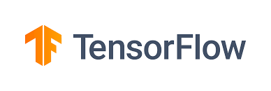
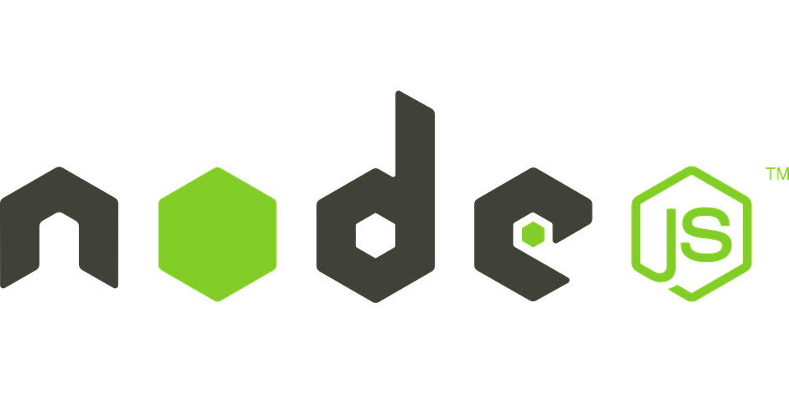
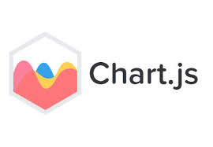


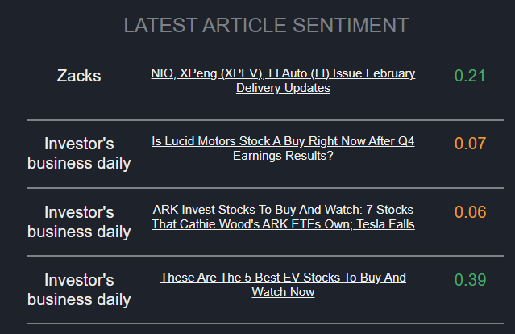

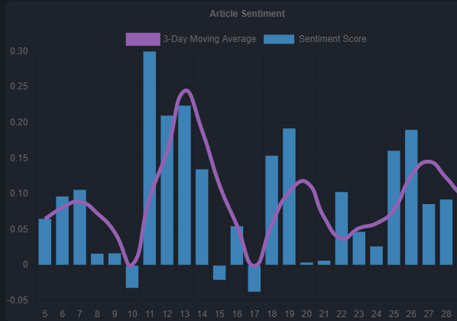





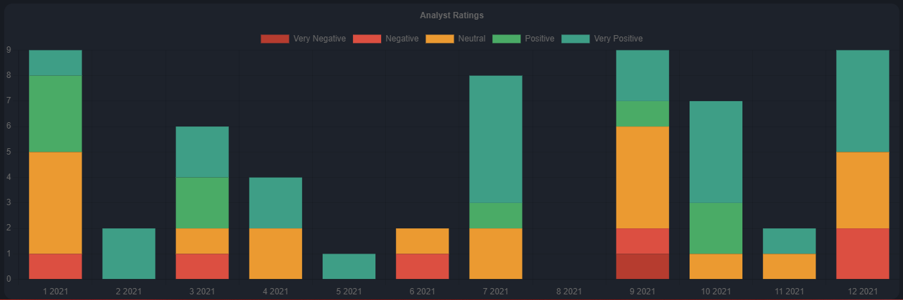


Stock Dashboard using Python and JS
Andris Vaivods, Supervisor: Jon Chamberlain
The Stock Dashboard is a website where the user can view live data on stocks, such as their article sentiment, analyst target prices, stock predictions and more, all made in the backend Python pipeline. The article data is web scraped and then cleaned using BeautifulSoup and Pandas. Topics are extracted from the text and sentiment is analysed using a lexicon-based approach with the VADER sentiment analyser. Stock price predictions are made using historical prices and a Long short-term memory (LSTM) neural network. All the data is stored on MongoDB Atlas and is visualized on the website using Node.js, Express.js and Chart.js
Topic Extraction
After removing stop words and performing Lemmatisation, the data is put into a dictionary and converted into a doc-term matrix. I use the genism Latent Dirichlet Allocation (LDA) model to generate topics for articles in the last 2 weeks. After which I assign a % to each topic depending on how many articles are about it.
Price Prediction
Generate a model for each stock to predict the future price using historic data features in a LSTM neural network model. Save the model for later predictions.
Data Visualization
Setup a Node.js server to access the database and visualize the data using Express.js and Chart.JS
Sentiment Analysis
After cleaning the data, I get the sentiment of each article using a lexicon approach with the Vader Sentiment Intensity Analyser. I analyse the sentiment of the title as well as the text, but only for the articles that are marked as important. Each article is given a sentiment score from -1 to 1.
Web Scraping
I extracted data such as articles and their text, and fundamental information, from Finviz.com, and used the Yahoo finance API to get the historic price and analyst ratings. For web scraping I used the Requests library to open the corresponding stock page on Finviz as well as to open the original article.
Database
Save all the information about the stocks like articles – their sentiment and topics, price predictions, and other web scraped information to dictionaries and store it in the MongoDB Cloud Database.

